Slide 1
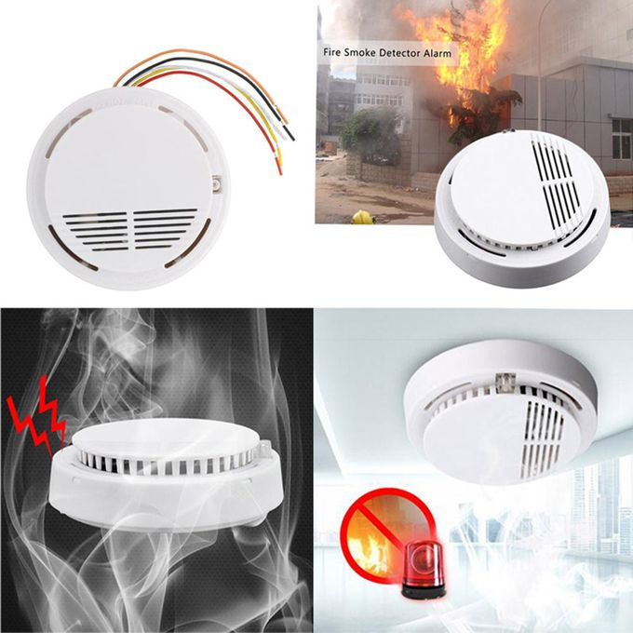
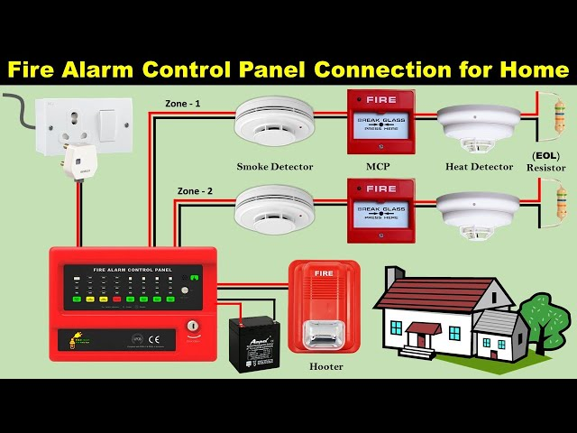
Smart Fire / Smoke Warning System
V Priyangan
ID: 25197298

Slide 2
System
Idea
Input Sensors:
S= Smoke sensor
T=Temperature sensor
3. R=Reset Buton
4. M=Manual Test Switch
Outputs:
W = Warning (YellowLed/ Slow Buzzer)
A = Alarm (Red Led, Fast Buzzer)
E = Evacuate (Continuous Buzzer+Blinking Red)

Slide 3
Logic Concept:
STATUS | GREEN | YELLOW | RED | BUZZER
Safe | ON |  |  | Silent
Warning |  | ON |  | Slow
Alarm |  |  | ON | Fast
Evacuate |  |  | Flashing | Continuous
Reset | ON |  |  | Silent

Slide 4

Logic Gate
WARNING
W = S OR T
EVACUATE
Logic Gate
E = (S AND T) AND
NOT R
ALARM
A = A AND T

Slide 5
Truth Table
W = OR A = AND E = ( AND + NOT R )
S | T | R | W | A | E
0 | 0 | 0 | 0 | 0 | 0
0 | 0 | 1 | 0 | 0 | 0
0 | 1 | 0 | 1 | 0 | 0
0 | 1 | 1 | 1 | 0 | 0
1 | 0 | 0 | 1 | 0 | 0
1 | 0 | 1 | 1 | 0 | 0
1 | 1 | 0 | 1 | 1 | 1
1 | 1 | 1 | 1 | 1 | 0

Slide 6
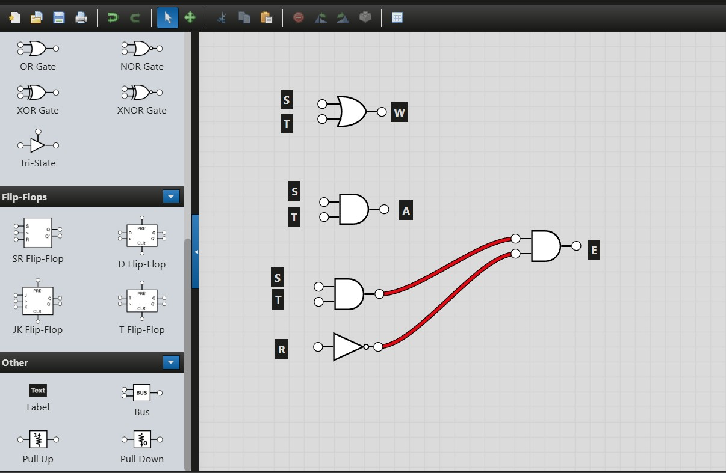
Logic Gates Diagram
LOGIC.LY

Slide 7
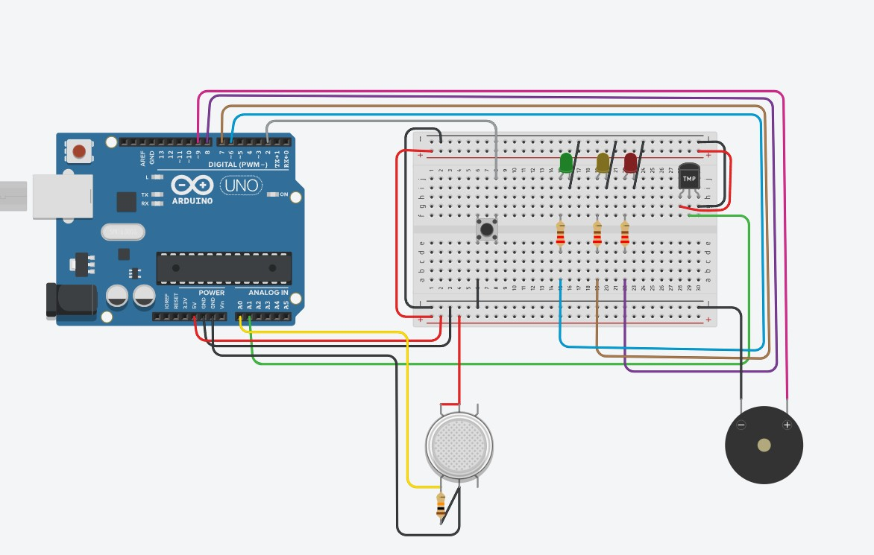
TINKERCAD Design
https://www.tinkercad.com/things/4fJy21QMP8D/editel?returnTo=%2Fdashboard&sharecode=hoFBjsEa2PsuOEFNwhZwsNTVHu7_IZqmhv1quBh3Kqw

Slide 8
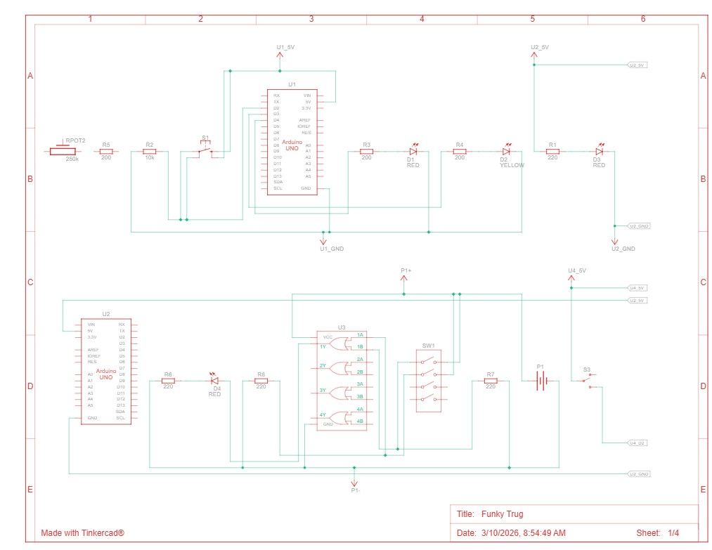
SCHEMATIC VIEW
TINKERCAD.COM

Slide 9
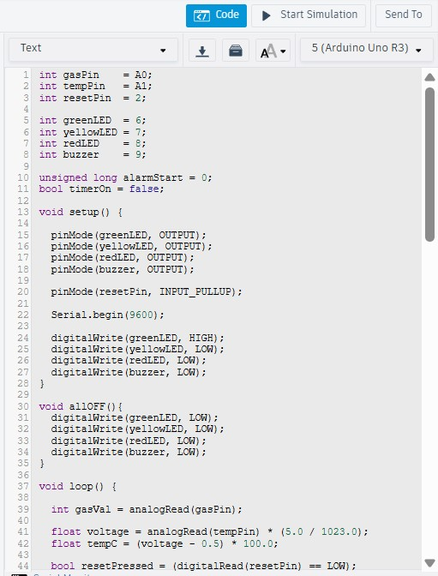
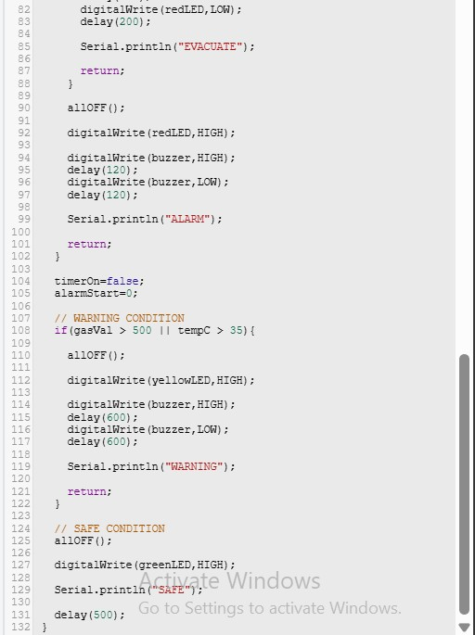
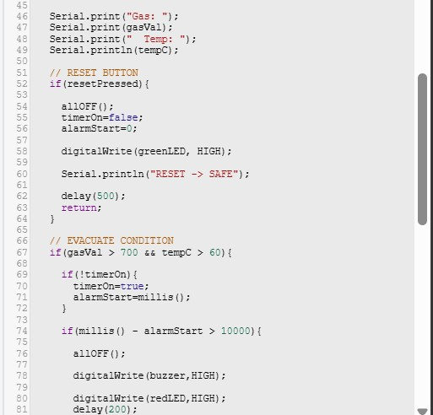
C++
TINKERCAD

Slide 10
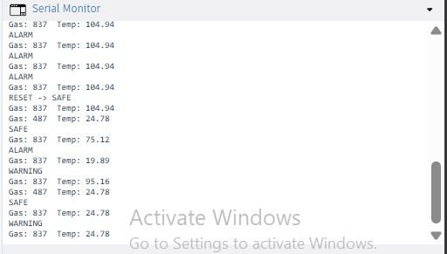
Serial Monitor View
TINKERCAD

Slide 11
Logic Gate
Thank you
I hope you understand
everything clearly.
V Priyangan - 25197298

Slide 12
References for Smoke and Fire Alarm System Project
Journal / Research Papers 1. Kunver Arif Ali et al., “Fire Alarm Systems.” International Journal for Research in Applied Science and Engineering Technology, 2023.
Promise Elechi, “Design and Implementation of an Improved Smoke Detection System.” European Journal of Electrical Engineering and Computer Science, 2017.
Mohamad Syafiq Mohamad Adenan et al., “Smart Smoke Detector.” International Journal of Recent Technology and Applied Science, 2021.
Sreejith S. P., Kuldeep Baban Vayadande, “Advanced Fire Monitoring System.” International Journal of Trend in Scientific Research and Development, 2020.
Robert S. Allison et al., “Sensors for Fire and Smoke Monitoring.” Sensors Journal, 2021

